Slide 1
Performance Metrics for Classification problems in Machine Learning

Slide 2
Agenda
1. Confusion Matrix:
2. Accuracy:
3. Precision:

Slide 3
Recurrence of Breast Cancer
The breast cancer dataset is a standard machine learning dataset. It contains 9 attributes describing 286 women that have suffered and survived breast cancer and whether or not breast cancer recurred within 5 years.
It is a binary classification problem. Of the 286 women, 201 did not suffer a recurrence of breast cancer, leaving the remaining 85 that did.
I think that False Negatives are probably worse than False Positives for this problem. Do you agree? More detailed screening can clear the False Positives, but False Negatives are sent home and lost to follow-up evaluation.

Slide 4
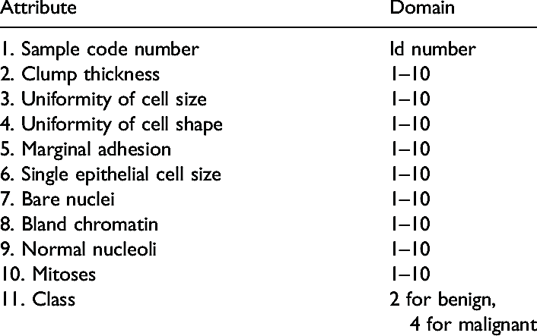
Problem : Recurrence of Breast Cancer
The breast cancer dataset is a standard machine learning dataset.
It contains 9 attributes describing 286 women that have suffered and survived breast cancer and whether or not breast cancer recurred within 5 years.
It is a binary classification problem. Of the 286 women, 201 did not suffer a recurrence of breast cancer, leaving the remaining 85 that did.

Slide 5

What do you mean by performance?
“Numbers have an important story to tell. They rely on you to give them a voice.” — Stephen Few
Our client will provide us with a new dataset (testing set).
Our objective is to have the best performance.
To find out how effective is the model based on some metric using test datasets.
Different performance metrics are used to evaluate different Machine Learning Algorithms.
The metrics that you choose to evaluate your machine learning model is very important.
Choice of metrics influences how the performance of machine learning algorithms is measured and compared. Before wasting any more time, let’s jump right in and see what those metrics are.

Slide 6
What is a Confusion Matrix?
A confusion matrix is a summary of prediction results on a classification problem.
The number of correct and incorrect predictions are summarized with count values and broken down by each class. This is the key to the confusion matrix.
The confusion matrix shows the ways in which your classification model is confused when it makes predictions.
It gives you insight not only into the errors being made by your classifier but more importantly the types of errors that are being made.
It is this breakdown that overcomes the limitation of using classification accuracy alone.

Slide 7
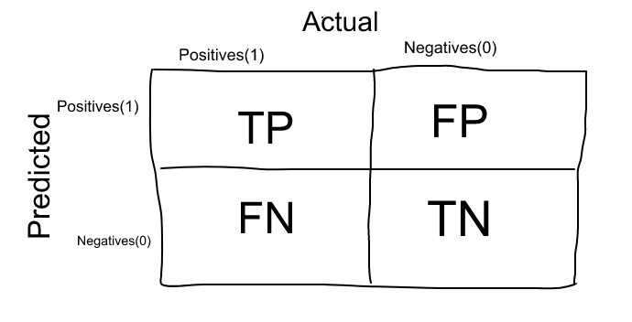
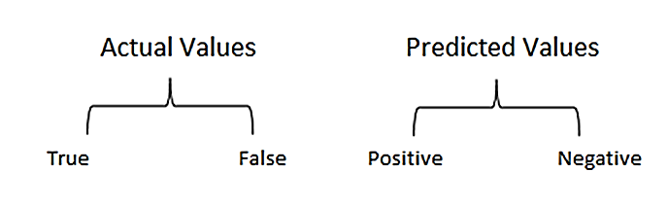
A confusion matrix, also known as an error matrix, is a specific table layout that allows visualization of the performance of an algorithm, typically a supervised learning one (in unsupervised learning it is usually called a matching matrix).
Well, it is a performance measurement for machine learning classification problem where output can be two or more classes. It is a table with 4 different combinations of predicted and actual values.
It is extremely useful for measuring Recall, Precision, Specificity, Accuracy and most importantly AUC-ROC Curve.

Slide 8
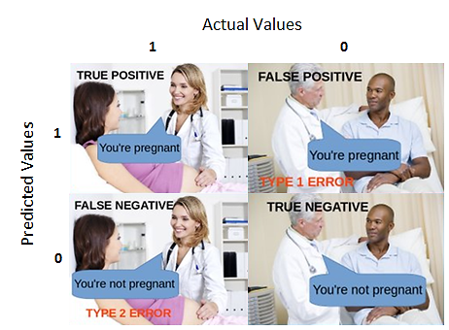
Let’s understand TP, FP, FN, TN in terms of pregnancy analogy.
True Positive:
Interpretation: You predicted positive and it’s true.
You predicted that a woman is pregnant and she actually is.
True Negative:
Interpretation: You predicted negative and it’s true.
You predicted that a man is not pregnant and he actually is not.
False Positive: (Type 1 Error)
Interpretation: You predicted positive and it’s false.
You predicted that a man is pregnant but he actually is not.
False Negative: (Type 2 Error)
Interpretation: You predicted negative and it’s false.
You predicted that a woman is not pregnant but she actually is.
Just Remember, We describe predicted values as Positive and Negative and actual values as True and False.

Slide 9
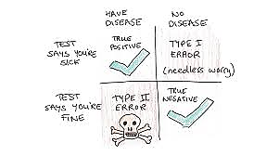
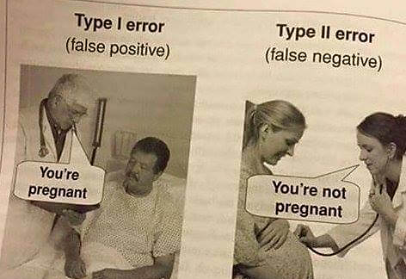
This is a classic case of ‘False Negative’ or Type II error. You want to avoid this at all costs, because, it says the patient is healthy when he is actually carrying malignant cells.
Also, the model predicted 11 instances as ‘Malignant’ when the patient was actually ‘Benign’. This is called ‘False Positive’ or Type I error.
This condition should also be avoided but in this case is not as dangerous as Type II error.

Slide 10
When to minimize what?
1. Minimising False Negatives:
Let’s say in our cancer detection problem example, out of 100 people, only 5 people have cancer.
In this case, we want to correctly classify all the cancerous patients as even a very BAD model(Predicting everyone as NON-Cancerous) will give us a 95% accuracy(will come to what accuracy is).
But, in order to capture all cancer cases, we might end up making a classification when the person actually NOT having cancer is classified as Cancerous.
This might be okay as it is less dangerous than NOT identifying/capturing a cancerous patient since we will anyway send the cancer cases for further examination and reports.
But missing a cancer patient will be a huge mistake as no further examination will be done on them.

Slide 11
2. Minimising False Positives:
For better understanding of False Positives, let’s use a different example where the model classifies whether an email is spam or not
Let’s say that you are expecting an important email like hearing back from a recruiter or awaiting an admit letter from a university. Let’s assign a label to the target variable and say,1: “Email is a spam” and 0:”Email is not a spam”
Suppose the Model classifies that important email that you are desperately waiting for, as Spam(case of False positive). Now, in this situation, this is pretty bad than classifying a spam email as important or not spam since in that case, we can still go ahead and manually delete it and it’s not a pain if it happens once a while. So in case of Spam email classification, minimising False positives is more important than False Negatives.

Slide 12
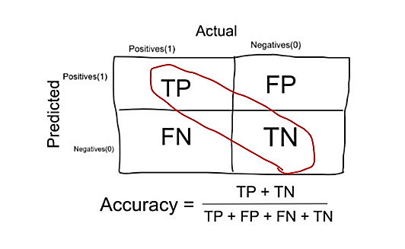
2.Accuracy
Accuracy simply measures how often the classifier makes the correct prediction.
It’s the ratio between the number of correct predictions and the total number of predictions (the number of test data points).
In the Numerator, are our correct predictions (True positives and True Negatives)(Marked as red in the fig above) and in the denominator, are the kind of all predictions made by the algorithm(Right as well as wrong ones).

Slide 13
When to use Accuracy:
Accuracy is a good measure when the target variable classes in the data are nearly balanced.
Ex:60% classes in our fruits images data are apple and 40% are oranges.
A model which predicts whether a new image is Apple or an Orange, 97% of times correctly is a very good measure in this example.
When NOT to use Accuracy:
Accuracy should NEVER be used as a measure when the target variable classes in the data are a majority of one class.
Ex: In our cancer detection example with 100 people, only 5 people has cancer. Let’s say our model is very bad and predicts every case as No Cancer. In doing so, it has classified those 95 non-cancer patients correctly and 5 cancerous patients as Non-cancerous. Now even though the model is terrible at predicting cancer, The accuracy of such a bad model is also 95%.

Slide 14
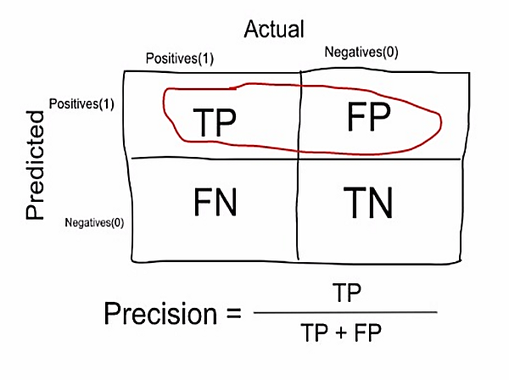
3. Precision:
Out of all the classes, how much we predicted correctly.
It should be high as possible.

Slide 15
Precision is a measure that tells us what proportion of patients that we diagnosed as having cancer, actually had cancer. The predicted positives (People predicted as cancerous are TP and FP) and the people actually having a cancer are TP.
Ex: In our cancer example with 100 people, only 5 people have cancer. Let’s say our model is very bad and predicts every case as Cancer. Since we are predicting everyone as having cancer, our denominator(True positives and False Positives) is 100 and the numerator, person having cancer and the model predicting his case as cancer is 5. So in this example, we can say that Precision of such model is 5%.

Slide 16
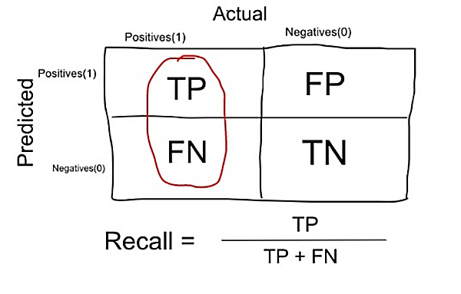
4. Recall or Sensitivity:
Out of all the positive classes, how much we predicted correctly.
It should be high as possible.

Slide 17
Recall is a measure that tells us what proportion of patients that actually had cancer was diagnosed by the algorithm as having cancer. The actual positives (People having cancer are TP and FN) and the people diagnosed by the model having a cancer are TP. (Note: FN is included because the Person actually had a cancer even though the model predicted otherwise).
Ex: In our cancer example with 100 people, 5 people actually have cancer. Let’s say that the model predicts every case as cancer.
So our denominator(True positives and False Negatives) is 5 and the numerator, person having cancer and the model predicting his case as cancer is also 5(Since we predicted 5 cancer cases correctly). So in this example, we can say that the Recall of such model is 100%. And Precision of such a model(As we saw above) is 5%

Slide 18
When to use Precision and When to use Recall?:
It is clear that recall gives us information about a classifier’s performance with respect to false negatives (how many did we miss), while precision gives us information about its performance with respect to false positives(how many did we caught).
Precision is about being precise. So even if we managed to capture only one cancer case, and we captured it correctly, then we are 100% precise.
Recall is not so much about capturing cases correctly but more about capturing all cases that have “cancer” with the answer as “cancer”. So if we simply always say every case as “cancer”, we have 100% recall.
So basically if we want to focus more on minimising False Negatives, we would want our Recall to be as close to 100% as possible without precision being too bad and if we want to focus on minimising False positives, then our focus should be to make Precision as close to 100% as possible.

Slide 19
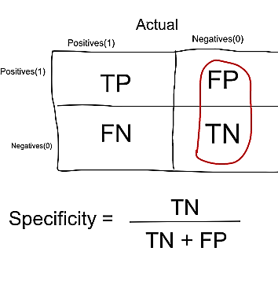
5. Specificity:
Specificity is a measure that tells us what proportion of patients that did NOT have cancer, were predicted by the model as non-cancerous. The actual negatives (People actually NOT having cancer are FP and TN) and the people diagnosed by us not having cancer are TN. (Note: FP is included because the Person did NOT actually have cancer even though the model predicted otherwise).
Specificity is the exact opposite of Recall.
Ex: In our cancer example with 100 people, 5 people actually have cancer. Let’s say that the model predicts every case as cancer.
So our denominator(False positives and True Negatives) is 95 and the numerator, person not having cancer and the model predicting his case as no cancer is 0 (Since we predicted every case as cancer). So in this example, we can that that Specificity of such model is 0%.

Slide 20
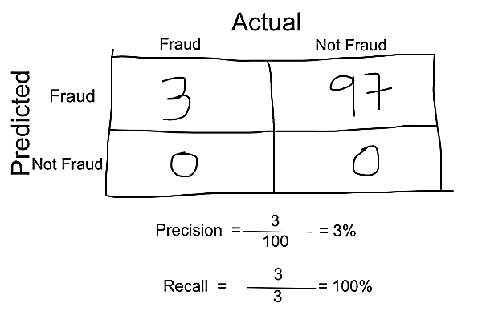
6. F-measure: F1 Score:
We don’t really want to carry both Precision and Recall in our pockets every time we make a model for solving a classification problem.
So it’s best if we can get a single score that kind of represents both Precision(P) and Recall(R).
F-score helps to measure Recall and Precision at the same time.
It uses Harmonic Mean in place of Arithmetic Mean by punishing the extreme values more.
One way to do that is simply taking their arithmetic mean. i.e (P + R) / 2 where P is Precision and R is Recall. But that’s pretty bad in some situations.
Suppose we have 100 credit card transactions, of which 97 are legit and 3 are fraud and let’s say we came up a model that predicts everything as fraud. (Horrendous right!?)
Precision and Recall for the example is shown in the fig below.
Precision and Recall for Credit Card example

Slide 21

The F1 Score is the 2*((precision*recall)/(precision+recall)).
It is also called the F Score or the F Measure. Put another way, the F1 score conveys the balance between the precision and the recall.

Slide 22
The range for F1 Score is [0, 1].
It tells you how precise your classifier is (how many instances it classifies correctly), as well as how robust it is (it does not miss a significant number of instances).
High precision but lower recall, gives you an extremely accurate, but it then misses a large number of instances that are difficult to classify. The greater the F1 Score, the better is the performance of our model
F1 Score tries to find the balance between precision and recall.

Slide 23
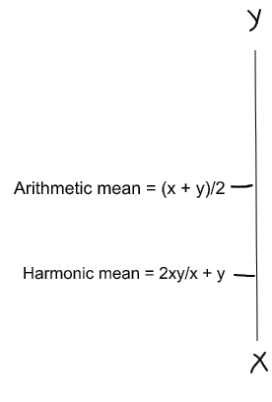
Now, if we simply take arithmetic mean of both, then it comes out to be nearly 51%. We shouldn’t be giving such a moderate score to a terrible model since it’s just predicting every transaction as fraud.
So, we need something more balanced than the arithmetic mean and that is harmonic mean.
Arithmetic Mean vs Harmonic Mean
The Harmonic mean is given by the formula shown in the figure on the left.
Harmonic mean is kind of an average when x and y are equal. But when x and y are different, then it’s closer to the smaller number as compared to the larger number.
For our previous example, F1 Score = Harmonic Mean(Precision, Recall)
F1 Score = 2 * Precision * Recall / (Precision + Recall) = 2*3*100/103 = 5%
So if one number is really small between precision and recall, the F1 Score kind of raises a flag and is more closer to the smaller number than the bigger one, giving the model an appropriate score rather than just an arithmetic mean.

Slide 24
Summary
Accuracy : the proportion of the total number of predictions that were correct.
Positive Predictive Value or Precision : the proportion of positive cases that were correctly identified.
Negative Predictive Value : the proportion of negative cases that were correctly identified.
Sensitivity or Recall : the proportion of actual positive cases which are correctly identified.
Specificity : the proportion of actual negative cases which are correctly identified.

Slide 25
Try
Example Confusion Matrix in Python with scikit-learn
The scikit-learn library for machine learning in Python can calculate a confusion matrix.
Given an array or list of expected values and a list of predictions from your machine learning model, the confusion_matrix() function will calculate a confusion matrix and return the result as an array. You can then print this array and interpret the results.

Slide 26
https://machinelearningmastery.com/roc-curves-and-precision-recall-curves-for-classification-in-python/

